Slide 1
Quality awareness

Slide 2

Quality
Quality is a way of life!
Quality is "conformance to the requirements”
Quality is “to solve business need”
Kaizen (continual improvements)
Quality =
Functionality *
(what the system does)
System Qualities
(how well it does it)

Slide 3
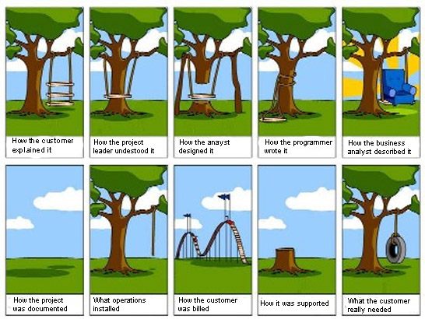
Quality

Slide 4

What is said!
Quality is free!
Quality awareness saves the total cost of delivery
by reducing the cycle time &
efforts required to put in
What it brings
To delight clients, not only satisfaction
To get repeat business, helps to grow business
Brand value for the organisation
Employee happiness & feel good factor

Slide 5

Thought Process
Quality is an intrinsic culture of our organization.
Quality function is to be called a Mission.
Quality is Not-negotiable !!!

Slide 6
Zero defect Mission
India's Mission to Mars is a spectacular success
Mangal yaan project was conceived in ‘10, Approved on 3rd Aug’12
In just 14 Months the Mars Orbiter was launched on 5th Nov. 2013
For an 'Unknown' journey, with many 'Don't know' areas
Inspiring towards greater performance
First Time Right
Complete Visualization
Courage of Challenging task
Perfect Execution
Perfect Collaboration (13 disciplines of expertise Electrical Engineering, Mechanical engineering, Chemical, Civil, Metallurgical, Telecommunication, Electronics, Computer hardware, Astrophysics, Software, Solar energy, Aeronautics and Mathematics)
Perfect Project Management - Amazing Planning, Just in 14 months
Perfect cutting edge Technology - No consultant to advise
Perfect Process - All interdependencies worked out
Perfect Testing without (User Acceptance Testing) - Just Zero defect

Slide 7


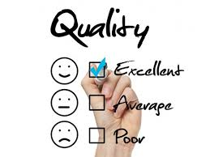
How it impacts!
What makes client irritate?
UI OR minor defects detected within three hours of delivery. Thus those are the most critical in nature
Functional defect detected within a day of testing
Rate of defect detection exceeding 1 defect per day
What makes client delight?
Graphics is as agreed during requirement analysis
Functions working as per agreed functionality
Defects not detected during first day of testing

Slide 8

Objectives
Reduced total duration, efforts and thus cost of delivery
To test comprehensively assuring quality delivery
Maximizing preproduction defects detection
Minimizing the post-production defects
Robust set up processes leading to person independent
Enhance reputation
Environment | Objective* | Remark
Preproduction (Internal) | 15-20 defects per man month of efforts, incl. code review | To be maximized
Preproduction (External) | Not more than 1 defect per 5 man month of efforts | To be as minimum
Postproduction | Zero defect post delivery | Sincere attempt
* - example

Slide 9
Achieving Quality
Defects are injected during Requirement analysis, High & Low level Design and coding phase
Continuous reviews help to prevent defect injection
Rigorous testing during Unit level, Integration and application level testing detect the defects
Both of above processes remove the defects
RA | R | Design | R | Coding | R | UT | IT | AT

Slide 10
Achieving Quality
Clear understanding of the requirements
(e.g. asking right questions, brainstorming sessions)
Continuous reviews of project artifacts by self & supervisor help to prevent defect injection
Detect as many defects during various phases
Defects in system
RA Design Coding UT IT AT
Various Phases of SDLC

Slide 11

Challenging Ownership and Responsibility
A question posed to self
By developer
How can there be a defect in a code developed by me?
Solution - To ensure defect free code
By tester
Why I did not find a defect which customer could find?
Solution - To identify maximum defects before delivering
By manager
How can I improve on quality of my delivery?
Solution – To identify quality improvements as a continuous process
Notes:
by upgrading angular and other maintenance tickets

Slide 12


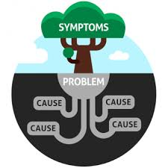

Actions for improvement
Prevention
Detection
Root cause analysis &
Corrections
Measurement

Slide 13

Preventions
Encouraging “first time right” approach
Effectively using tools and technologies
Implementing the best proven practices
(coding standard, leverage IDE and static analysis tool, automated unit test cases , continuous integration tools (Jenkin))
Avoiding repeat mistakes
Using check list
By way of stringent reviews of deliverables
By sharing experiences, compilation of learning

Slide 14
Preventions
While development & unit testing
Code review by tools, peer and supervisor
Continuous improvement of engineering capabilities
Sprint-wise/ phase wise retrospection & actions
While testing
Self reviews and self testing
Automation/ manual testing
Maximizing coverage of testing scenarios
Notes:
Sharing learning across projects

Slide 15

Detection
White box and black box testing
Writing test cases of maximum possible
coverage of various scenarios
Through end-to-end testing using both
manual and automation testing
Innovative testing (like defining common behavior patterns, component testing, etc.)

Slide 16

Measurement & Process
Detect defect pattern by measurement of type, cause, severity and numbers, by whom, etc.
Code Review comments per unit effort
No. of test cases per sprint (manual & Automated)
Written and
Executed
Preproduction and post production defects/sprint;
To capture the reasoning and analyze root causes
Notes:
Take appropriate actions to avoid repeat mistakes
and identify developer & tester
Test engineer to review the requirements

Slide 17
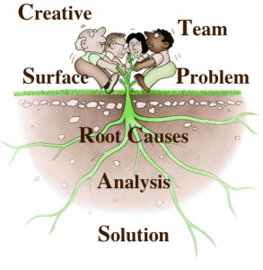
Root Cause Analysis
Conduct RCA, to derive and take appropriate actions post analysis to avoid repeat mistakes
Possible causes :
Unstable Environment
Insufficient requirements
Un-clear understanding of the requirements
Insufficient product / domain knowledge
Insufficient test cases or testing
Training need of resources
Not following correct engineering practices / processes
Too much dependency on manual testing
Notes:
Skills of developer or ignorance of developer

Slide 18





Actions for improvement
Testing Skill Enhancement
Strengthening the best engineering practices & processes
Black Box Testing; Acquire domain/apps knowledge,
New Testing Tools and Techniques Inculcation

Slide 19
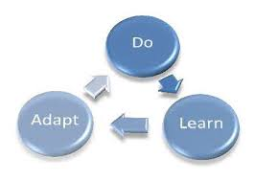
Skill enhancement
Writing a good test case is a skill…it needs to be learned
Test cases though well written might not cover 100% scenarios, so testers skills can play a role
If skills are higher, productivity will be higher

Slide 20
Training management
1
Identify Training needs using Skill Matrix
Plan training preparing the
calendar
Skill
Enhancement
Measure enhanced skills & Feedback
Execute Training by competent faculties

Slide 21
Strengthening Process
Follow engineering practices
Reviews (RA & Design document, Test plan, etc.)
Track quality progress
Use of test management tools
Measure defect leakages
Raise early warning signals
Root cause analysis
Actions to avoid repetition

Slide 22

Testing Tools & Technology Inculcation
Your two hands can do a lot, but not all.
Using apt tools and technologies can boost productivity considerably
Code Quality measurement tools
New testing tools and technologies
Conduct training on new tools and technologies & help projects
Publish white paper / develop proto application

Slide 23
Automate the testing
Automated testing is:
Faster
Reliable
Accurate
Reduces human & technical risks
Cost effective
So automate test cases

Slide 24
Popular test automation tools
Web UI test automation
Selenium – Open source test automation supporting multiple languages & platform
QTP – One of the oldest & reliable paid automation tool from HP.
Coded UI – Web testing automation tool from Microsoft.
Webservice test automation
SoapUI – To test SOAP & REST web services available in both free & paid versions.
Web Service studio – web service testing tool from Microsoft.
Mobile automation
Appium – Open source tool to test native & hybrid mobile apps for android & IOS
Selendroid – Open source test tool for mobile app testing
Winnium – Open source test mobile app automation tool for windows app
Performance test automation
Jmeter – Open source test automation for testing web application performance.
LoadRunner – Popular performance test automation from HP.
Web performance & load test (VSTS)

Slide 25






















Tools & Technology (Microsoft)
Requirement Management
Project
Management
Architecture & Design
Cloud provider
Architecture & Design
Development
Testing
Unit
testing
SCM
SCA
Microsoft Test Manager
Continuous Integration
or
Build
CI server
or
or
MS Build
Automation
testing
or
or
or
Coded UI Test
Repository management
or
or
ANT
or
Continuous Delivery/Deployment using DevOps
Release
management
Configuration management
Containerization
Continuous Monitoring
or
Note: Solution offering for on-premise & on-cloud

Slide 26


















Tools & Technology (Open Source)
Requirements management
Project
management
Architecture & Design
Cloud provider
Development
Testing
Development
Development
Test case management
Unit
testing
SCM
SCA
Continuous Integration
or
or
Build
CI server
or
Artifactory
management
or
Repository management
or
ANT
or
or
or
&
or
or
Automation
testing
Continuous Delivery/Deployment using DevOps
Configuration management
Containerization
Continuous Monitoring
or
or
ELK
Sysdig
cadvisor
Note: Solution offering for on-premise & on-cloud
26

Slide 27
Let’s do our job
If we can conduct all the tests on the software which the customer is going to conduct .. Why should we be delivering the defects…??

Slide 28

Thanks

